Slide 1

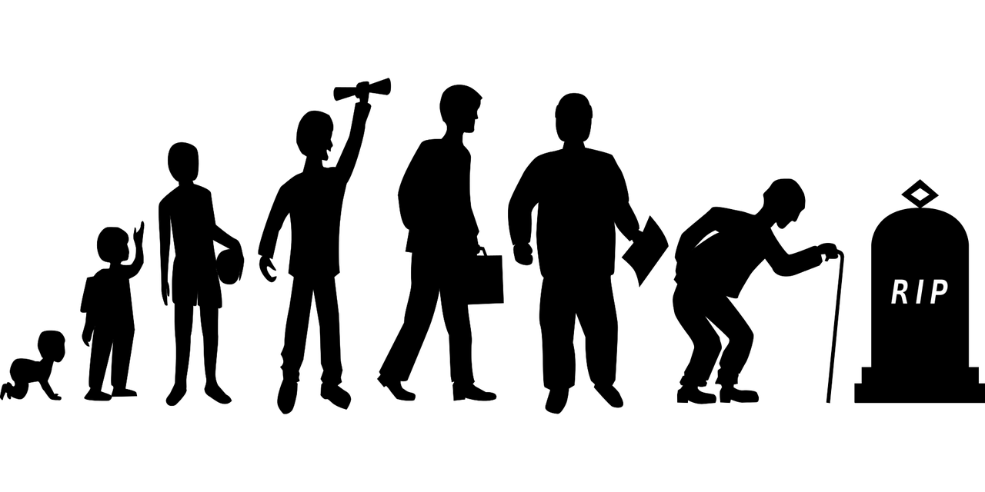
Life Expectancy Prediction

Slide 2
Objectives
The main objective of the Life Expectancy Prediction project is to create a machine learning-based system that can predict the life expectancy of a population based on various factors such as healthcare, education, lifestyle, and environmental conditions. The project aims to provide valuable insights into public health and guide policy decisions that can improve the quality of life for populations around the world.
Benefits
Improved Public Health
Efficient Resource Allocation
Accurate Predictions
Increased Awareness

Slide 3
Data Sharing Agreement
File used as dataset : Life Expectancy Data.csv
Number of Columns: 21
Number of Rows: 2938
Columns Name: ‘Life expectancy ', 'Adult Mortality', 'Alcohol', 'percentage expenditure', 'Hepatitis B', 'Measles ', ' BMI ', 'under-five deaths ', 'Polio', 'Total expenditure', ' HIV/AIDS', 'GDP', 'Population', ' thinness 1-19 years', ' thinness 5-9 years', 'Income composition of resources', 'Schooling', 'Developed’
Columns Datatype: float64 and int64

Slide 4
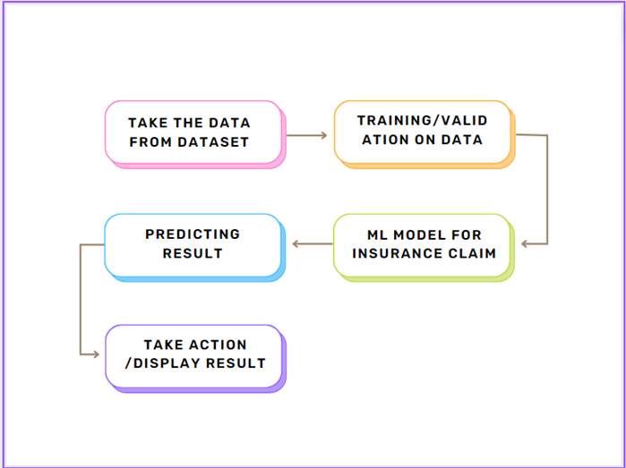
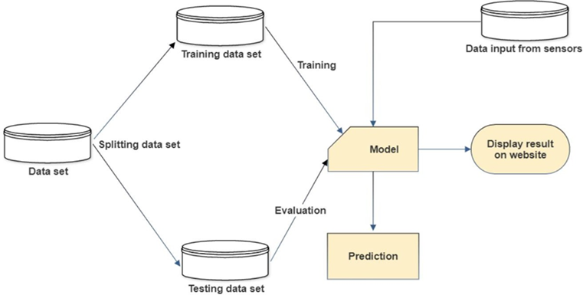
Architecture

Slide 5
Step 1: Data Preprocessing and EDA
Raw data contains 19 columns: ‘Life expectancy ', 'Adult Mortality', 'Alcohol', 'percentage expenditure', 'Hepatitis B', 'Measles ', ' BMI ', 'under-five deaths ', 'Polio', 'Total expenditure', ' HIV/AIDS', 'GDP', 'Population', ' thinness 1-19 years', ' thinness 5-9 years', 'Income composition of resources', 'Schooling', 'Developed’
We used DataPrep module to perform EDA on the data.
We only selected the important parameters and dropped the unnecessary columns.
Life expectectany can be calculated using these parameters and it is categorical data.

Slide 6
Step 2: Figuring the relations
Plot graphs of the features and target variable. This helps in visualizing the relationship between the different features and the target variable (i.e., life expectancy).
The plotted graphs help to identify trends, patterns, and outliers in the data, which can be used to make informed decisions. For example, a scatter plot can be used to visualize the relationship between two variables, such as the correlation between the percentage of adults with hepatitis B and life expectancy.

Slide 7
Step 3: Drawing more insights
A box plot can be used to visualize the distribution of a variable, such as the distribution of BMI across different countries.
These graphs help to identify any anomalies in the data, such as missing or erroneous data points, which can be further investigated and resolved.
Additionally, these graphs can help to identify any non-linear relationships between the variables, which can be incorporated into the machine learning models to improve their accuracy.

Slide 8
Step 4: Machine Learning Algorithms
Linear regression had great train accuracy but the root mean square error was higher
Tried some other machine learning models like Ada Boost Regressor, Gradient Boosting Regressor, Decision Tree Regressor, Decision Tree Regressor and SVR
The best suited algorithm was Random Forest Regressor. The accuracy of the model was 99.34% and the root mean square error was 0.69
Hence, we chose this algorithm.

Slide 9
Frequent Q&A
Q) What is the source of the data?
Although city-specific data can be obtained from that particular insurance provider or bank, the data was obtained from Kaggle.
Q) What is the complete flow of your project?
For a better understanding, see slide number 4.
Q) What techniques were you using for data pre-processing?
Data pre-processing involved analyzing the data, identifying the key characteristics, and removing the irrelevant columns based on the domain expertise. We also attempted to replace any missing values with the mean, median, and mode, but the correlations between the data remained the same. The better choice for us was to remove the columns with high NaN values.

Slide 10
Frequent Q&A
A1: How can information help in decision-making? The graph that came before this one is now updated. Also, it displays the same things with a little more value information. Variables are ranked according to importance in descending order. Impact: The horizontal placement indicates whether a higher or lower prediction is implied by the influence of that value.
A2: How can an individual country’s previous life expectancy alter the system's output? If a country has had a consistently high life expectancy value in the past, it may be assumed that the trend will continue in the future, and the model may predict a higher life expectancy value for that country in the present. On the other hand, if a country has had a consistently low life expectancy value in the past, the model may predict a lower life expectancy value for that country in the present.

